Slide 1

« Refrain from using the alphabet »
How community outreach catalyzed the life sciences at MIT
John Durant
Alexandre RICHARD - Matěj MAYET - François WU - Damien LUSSAN - Raphaël ROLLAND - Valentin DUVIVIER

Slide 2
Industrial context
An innovative period
A desire to innovate
Source of angel investing and venture capital
Source of skilled managers, entrepreneurs and mentors to support innovation
Critical for the formation of new firms and industries in biotechnology

Slide 3
Political issue
Government funding
1971 : Richard Nixon declares the « War on cancer »
1.6 Billion (US) dollar crusade
Birth of the MIT Center for Cancer Research

Slide 4
A new industry
The biotechnology
Discovery of the DNA in 1953 by Watson, Crick and Wilkins
Unifying concept for biology
MIT started to Focus on molecular biology at Kendall square
A field full of promises
A big breakthrough : the recombinant DNA (rDNA)

Slide 5
Controversy
« Tinkering with life »
Technical risks and a need for scientific accountability
Ethical problems followed by public debates
Crisis from science to politic

Slide 6
Timeline
II. The Berg letter
Discuss among scientists, through a moratorium.
IV. Gene town
Launch of biotechnology and enhanced relations with wider community.
III. PUBLIC DEBATE
I. TOPIC rDNA
1977
1979
V. CONCLUSION
1974
1972
1975
1976
II. SCIENTIFIC
ACCOUNTABILITY
IV. FURTHER EXPANSION
The rDNA
Pros and cons
Use of it
III. « Refrain from using the alphabet »
Public concerns on whether rDNA is harmful or not.

Slide 7
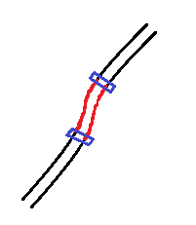
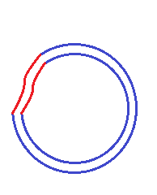
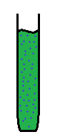
I. The rDNA
What is it ?
Restriction enzymes
Gene we wanted to extract
placed in the host plasmid
Vial
Solution with E. coli
and host plasmid
Gene we want to extract
Host plasmid
Solution with
bacteria E. coli
Giving gene DNA

Slide 8
I. The rDNA
Why a controversy ?
Unknown technology that could be a danger in case of errors
Potential of creating dangerous viruses and immunized bacterias
Role of science and technology in Vietnam War
The ethical problems

Slide 9
I. The rDNA
Pro and cons
Pro | Cons
Cure pathologies | Against the laws of nature
Improve vaccines and produce new ones using recombinant DNA technology | Potentially playing with too important forces, we couldn't control
New ways to study human genetics | Humans may begin tampering too much with their own genetic material and create societal problems

Slide 10
II. Scientific accountability
The "Berg" letter
Paul Berg an American biochemist
Pioneering work involving gene splicing of recombinant DNA (rDNA)
The Berg letter: a statement of conscience, not of conviction
Concerned about the consequences of his own discovery

Slide 11
II. Scientific accountability
The moratorium (1974)
"Moratorium" : a call to pause, to temporarily defer rDNA related experiments.
Meetings and discussions about the nature of the possible hazards, the kind of experiments that could be or should not be done, etc.
Proposition of framework, guidelines and recommandations for the National Institute of Health (NIH).
The moratorium was widely accepted all around the world among scientists.
Many scientists become socially responsible in their researches, especially due to late 1960s political movements.

Slide 12
II. Scientific accountability
International conference (1975)
Conference in Asilomar, California in 1975.
Scientists from around the world, also some lawyers, some ethicists, some members of the press.
Non-scientists were just as involved in the conference as the scientists.
Outcome:
Extension of the moratorium.
Detailed framework, guidelines and regulations for the NIH.
International analogous institutions set up similar measures.

Slide 13
II. Scientific accountability
Impact of the scientific world
Science had been moving incredibly fast, beyond the ability of the general public to assess it, to understand it, become comfortable with it.
Even scientists themselves requested a need to slow-down.
But many scientists were still eager to continue further reasearch in genetics and rDNA.

Slide 14
III. From a close to a public debate
Outside the research community
Berg letter's authors believed that the debate around rDNA would remain inside research communities.
1975-76: an increasing number of people got involved into this debate worrying about the risks of rDNA technology.

Slide 15


III. From a close to a public debate
Release of the final NIH guidelines
Announced by the US Department of Health, Education and Welfare
Expected to be adopted by the laboratories throughout the US and around the world
“The NIH guidelines will, effective today, govern research at laboratories of the NIH and those of its grantees and contractors. They are also expected to be adopted by other laboratories throughout the United States and foreign countries.”
Department of Health, Education and Welfare
June 23, 1976

Slide 16
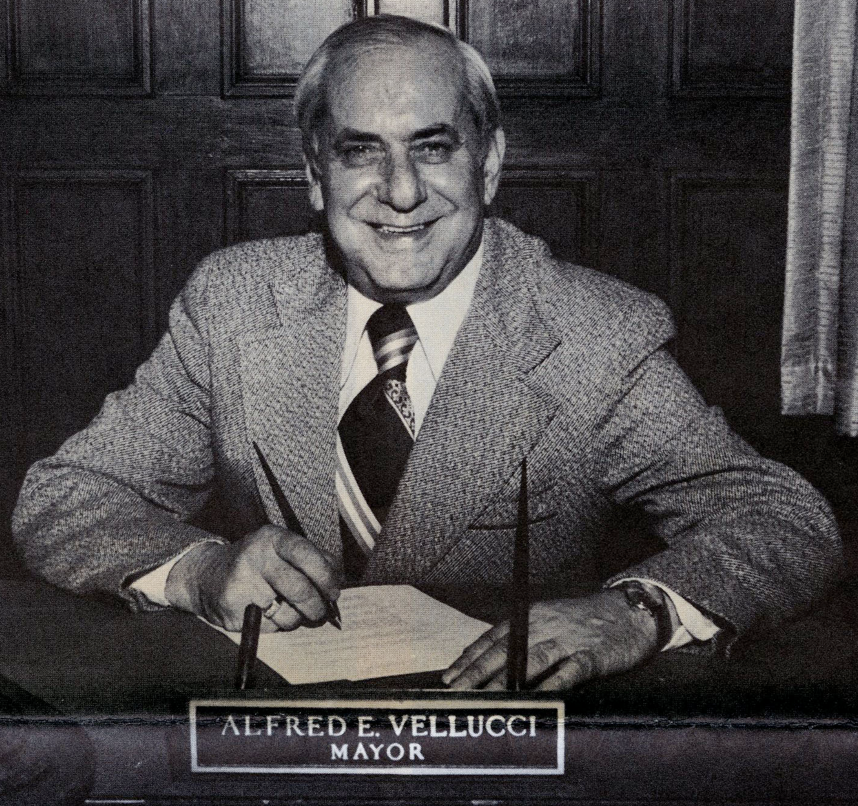
III. From a close to a public debate
Hearing on rDNA experiment in Cambridge
Organized by Mayor Alfred Vellucci
Willingness to involve the citizens into the debate
Hearing called after Harvard's proposal to build a P3 containment for rDNA research
Resolution of a two-year ban on all rDNA experimentation rejected at the end
"They may come up with a disease that can't be cured even a monster,… Is this the answer to Dr. Frankenstein's dream?“
Alfred Vellucci, Mayor of Cambridge, Massachussetts
June 23, 1976

Slide 17
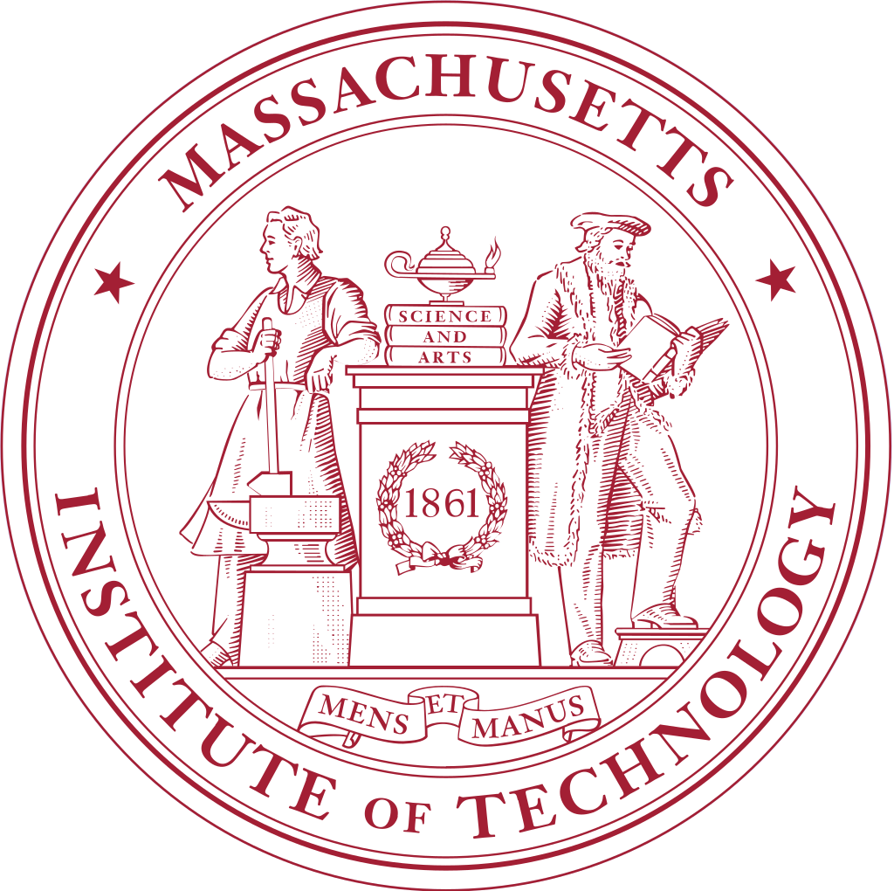
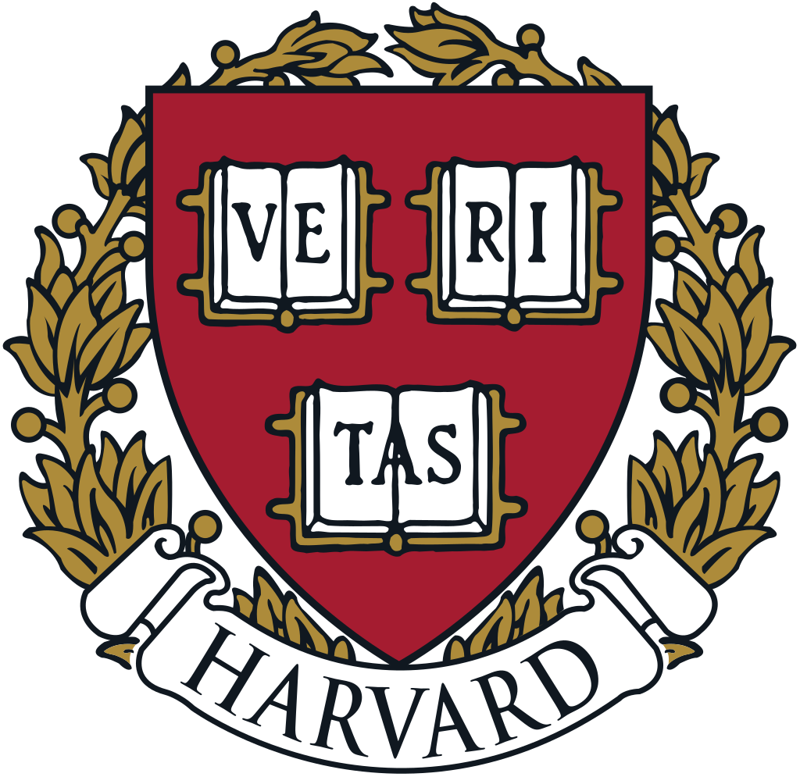
III. From a close to a public debate
Cambridge Experimentation Review Board
Established after the second meeting
A special body that will consider the question of whether rDNA experiments should be permitted in the city
November 1976: major debate between proponents and opponents of rDNA research
→ Regulation permitting rDNA research in Cambridge
→ First time where average citizens were involved into the decision-making concerning a new technology

Slide 18
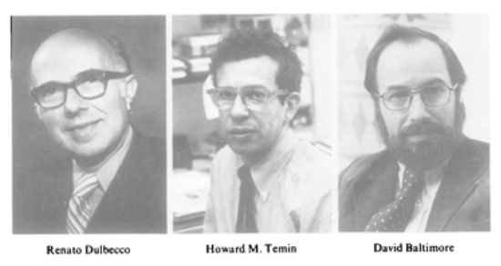
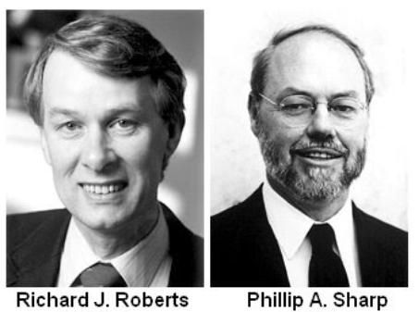
IV. Further expansion
Nobel prices
1975
1993

Slide 19
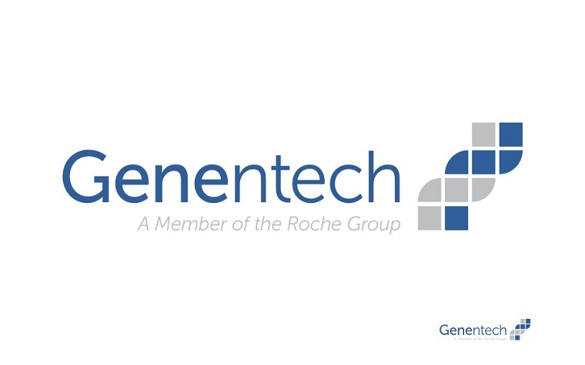

IV. Further expansion
Creation of research centers
1976
1979

Slide 20




IV. Further expansion
Evolution of the rDNA industry
Creation of new companies
Creation of Organization

Slide 21
IV. Further expansion
Author’s conclusion
« MIT is all the stronger
for having close and constructive relationships with the wider. »

Slide 22
V. Conclusion
Science
Politics
rDNA Ethic
Public

Slide 23
Ethic process
Diversity of the actors in innovation process
Part of a bigger process
To regulate innovation is a motor for innovation
Natural process

Slide 24
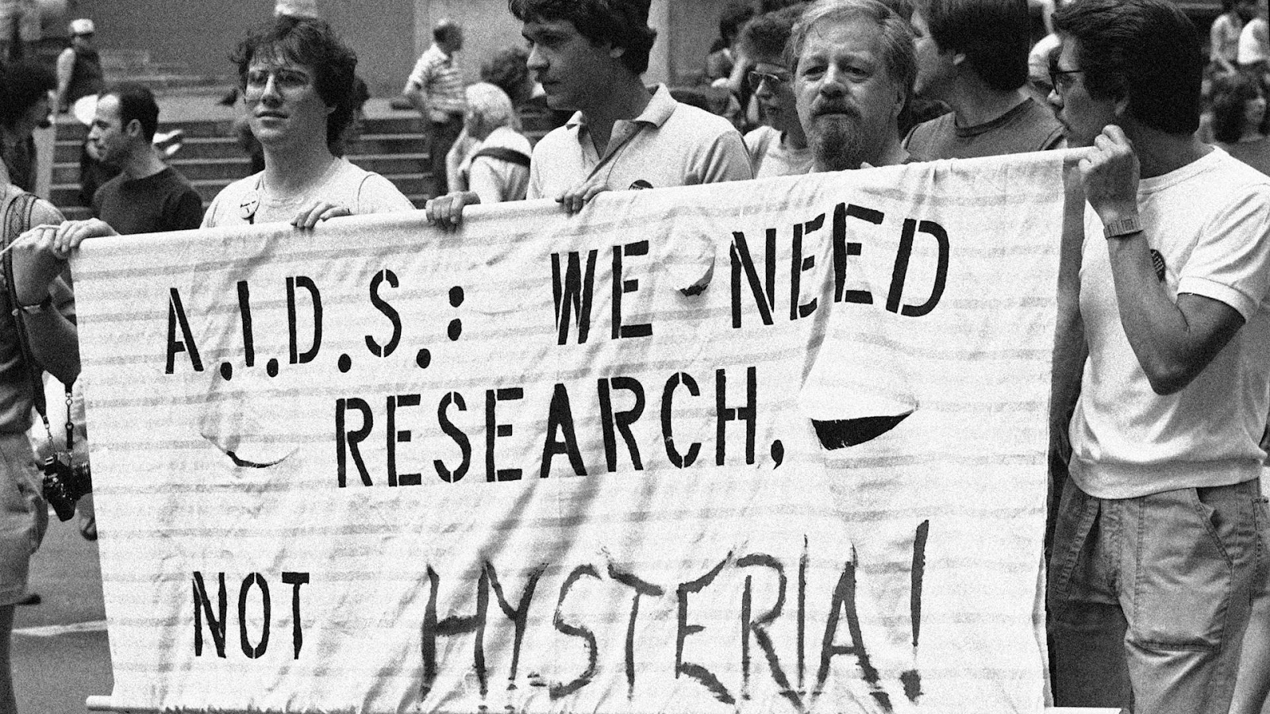
AIDS Example
1980s :
- Cases rose
- Cure process
Whether quick testing or long-term therapy ?
Testing process

Slide 25
Ethic process
Several included fields
Social bases for further
Methodological and controlled innovation process

